Slide 1
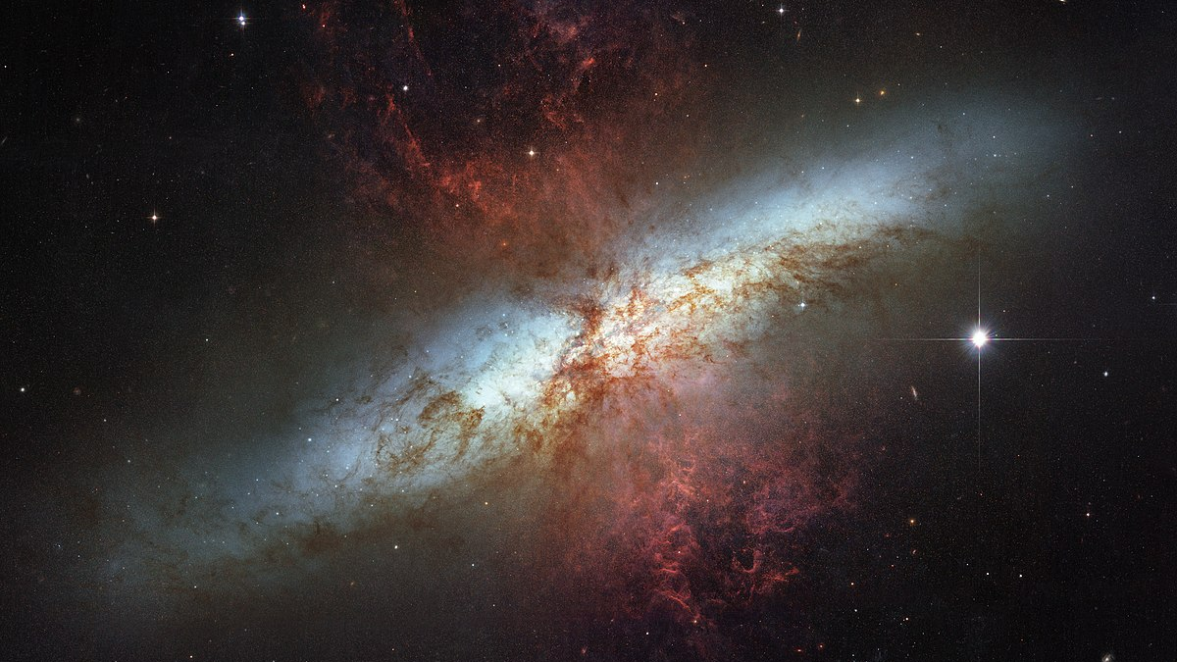
The low-cost future of space-based astronomy
Prof. Erika Hamden
University of Arizona
Advancing Australian participation in space-based astronomy
February 20th, 2025

Slide 2
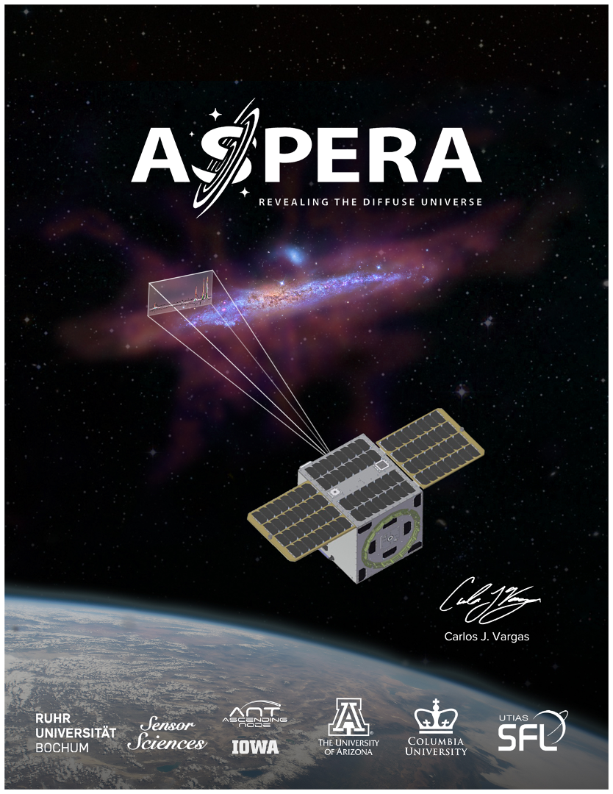
Funded by NASA
$20 Million, part of the Pioneers Program of small satellites
Anticipated Launch in 2026
9 months of operations
All my graduate student researchers are involved in critical components! Several opportunities for undergraduate work as well!

Slide 3
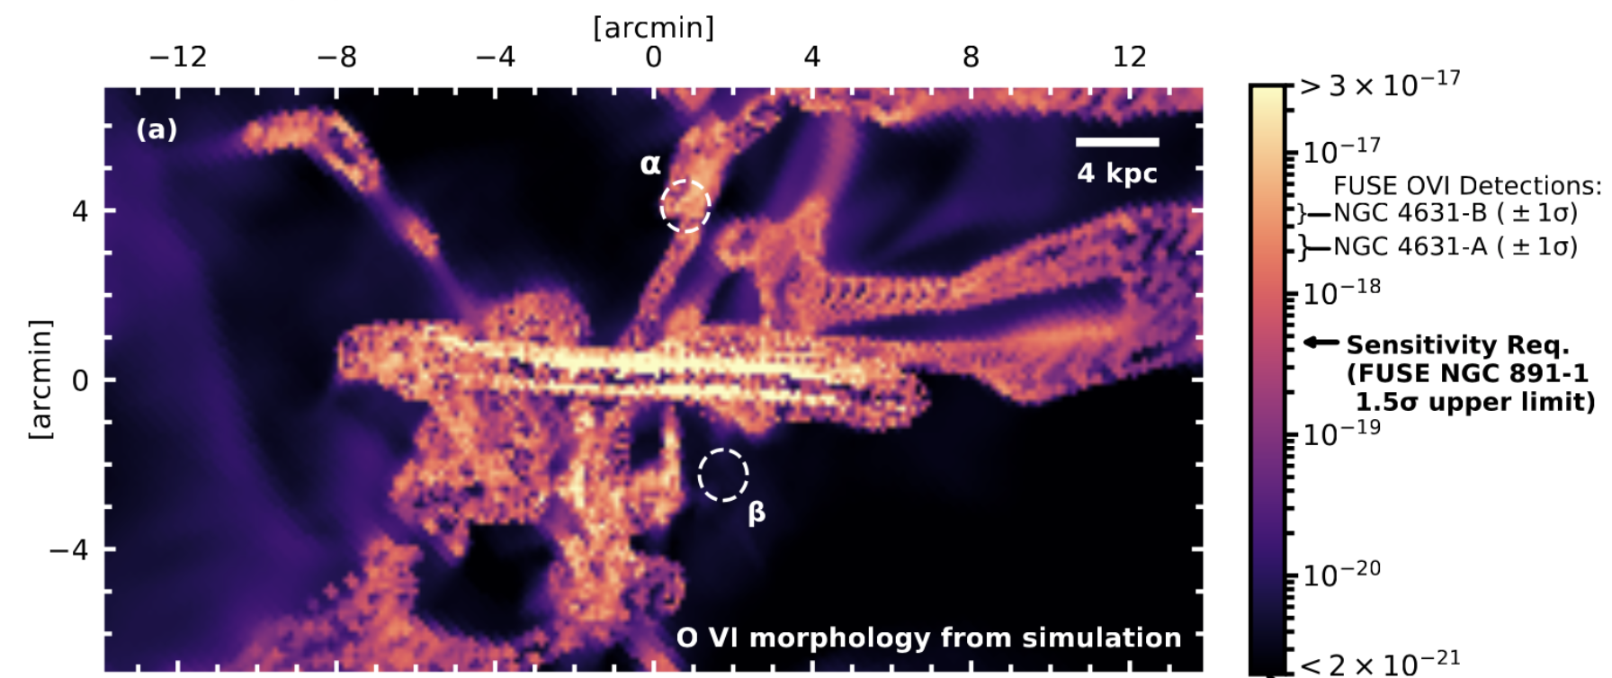
Aspera Mock Observation
Includes system response, spacecraft pointing/jitter, and aberration
Asterisks → SNR > 5
Exposure time → 2 days per pointing
14 days total

Slide 4
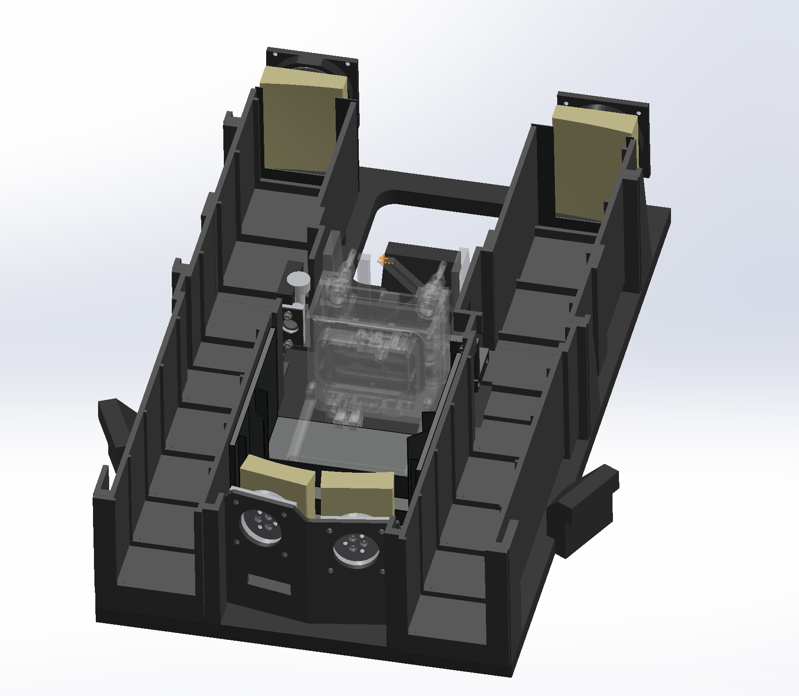
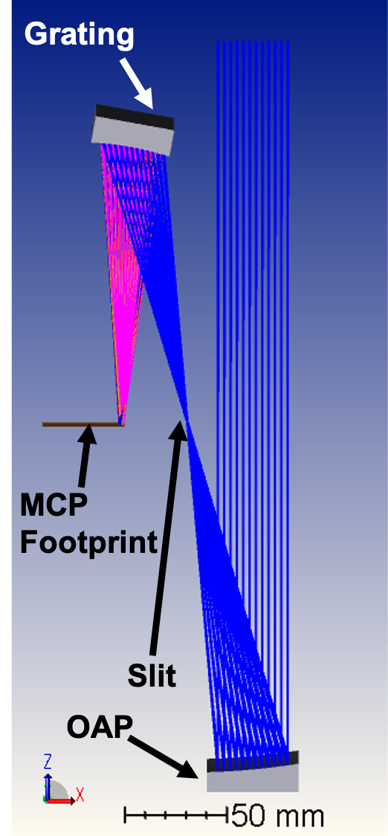
Aspera Payload
Efficient AND HIGH Heritage
2x Identical Rowland Circle-like optics
  Design inspired by FUSE
  2 channels with aligned FOVs
103-104 nm FUV spectrograph
  Spec R: ~2000, Spatial R: 45 arcsec
  FoV: 60 arcmin x 30 arcsec (per ch.)
Sensitivity: 4.3E-19 erg/s/cm²/arcsec²
TRL ≥ 6 Technologies
  Mirror, Grating, Coating, & Detector
Payload mass, power: 24 kg, 27 W
2x
See Chung et al. (2021; SPIE) for more

Slide 5
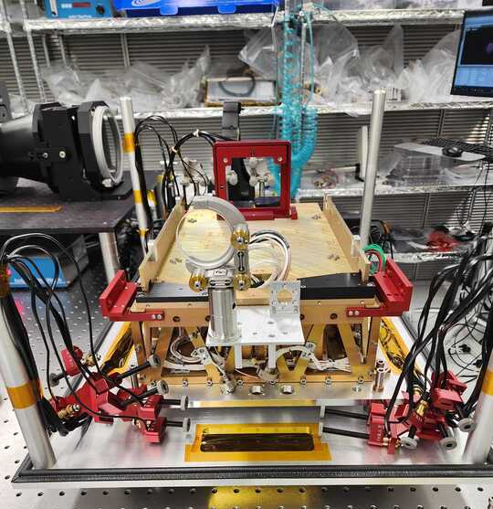
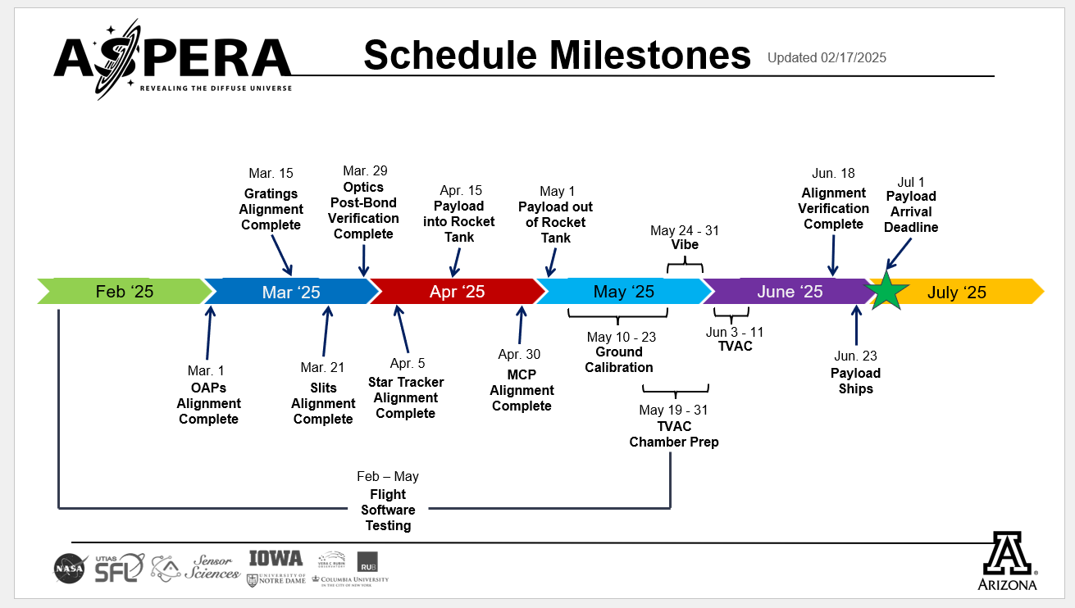
Current Status of Aspera:

Slide 6
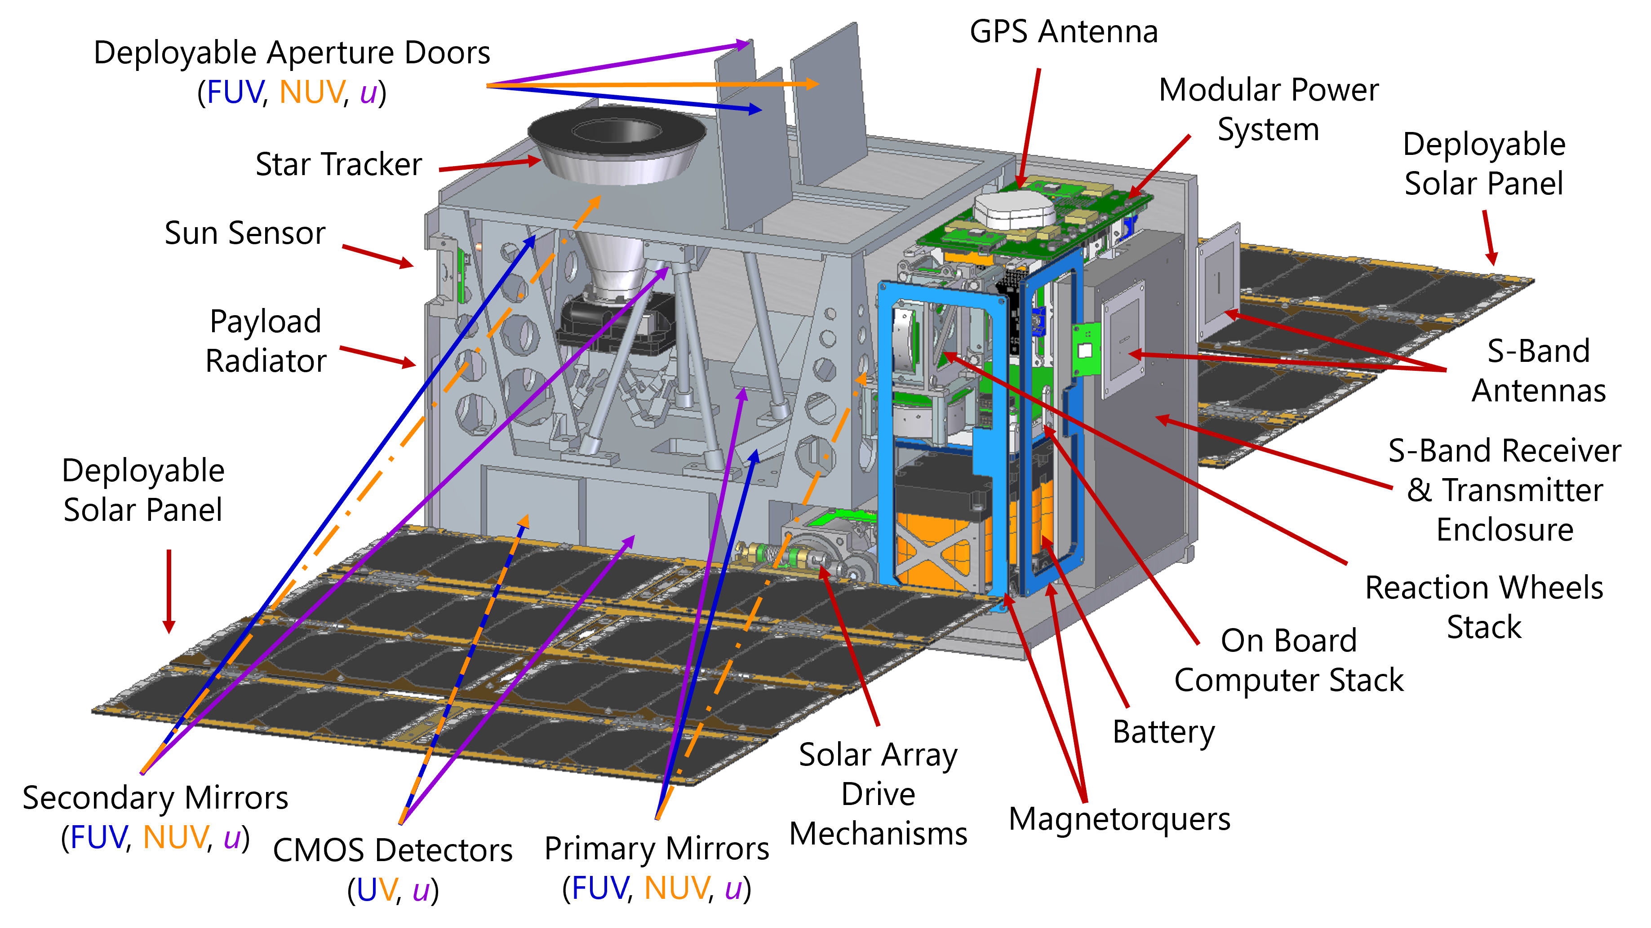
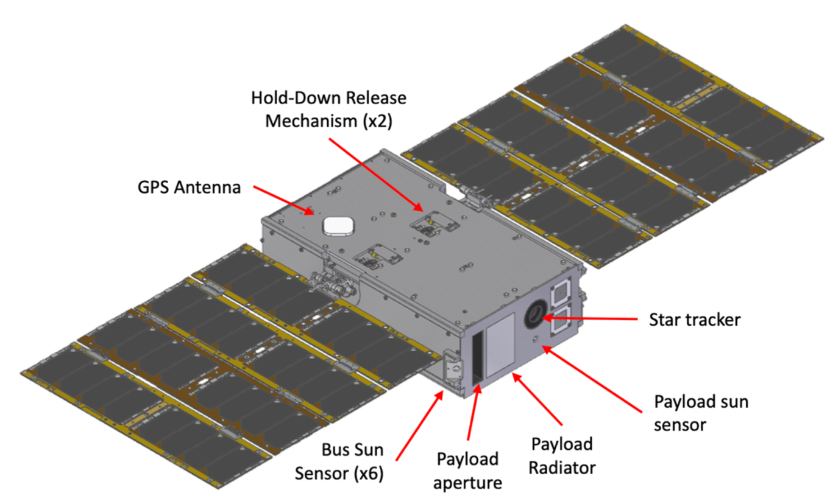
Additional Small Sat Projects
UVIa- A 16U APRA (<$10M USD) proposal to study Type Ia Supernovae in the UV and Visible (PI- Keri Hoadley)
GlowSat- A 6U APRA proposal to study the behavior of FUV airglow lines in Earth’s atmosphere (PI- Haeun Chung)

Slide 7
Enabling Technologies for these small missions
Low-cost access to space, ride shares, etc.
Vastly improved space craft availability, for example:
  Blue Canyon
  Terran Orbital
  Space Dynamics Lab
  Space Flight Labs (University of Toronto)
  NASA Ames (modular spacecraft bus)
  Thales Alenia
  Surry Satellite Technology
  Impulse
  Airbus
Much lower communications/operations costs
  Can use UHF, X-band, S-band from basic, homemade ground stations, or use larger networks of ground stations
Optics are easier to make, easier to align
Components are off the shelf

Slide 8
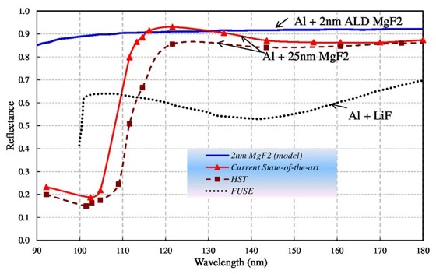
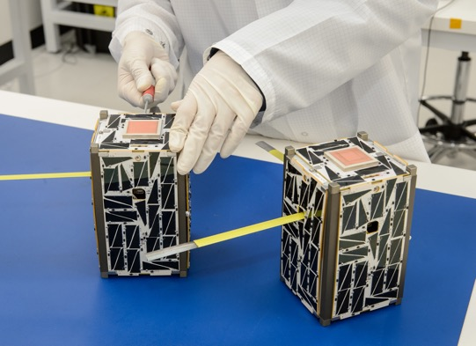
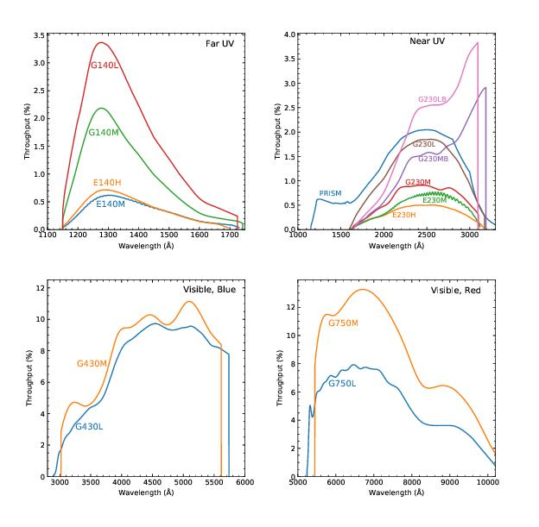
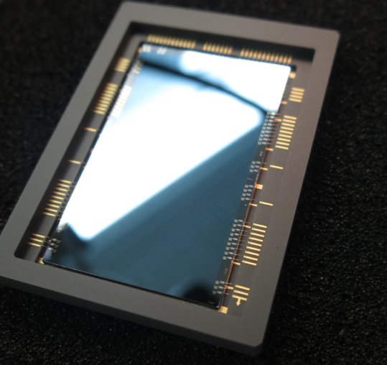
In the UV, vastly improved technology
I’m happy to talk at length anytime about UV detectors!
Notes:
Detectors, Gratings, Mirrors, Spacecraft

Slide 9
How well will future missions do?
Figure shows performance for a small sample of missions for the CGM line that Aspera observes.
Assumptions that future flagships will solve all problems are maybe wrong due to balance between large aperture and very small resolution elements.
Power of dedicated SmallSats: Aspera is equivalent to Explorer/Probe Class missions (again, resolution element size is key here)
Chung, Vargas, & Hamden, 2021
Notes:
LUVOIR A is 15M
LUVOIR B is 8M
CETUS is 1.5M
FUSE was 40cm by 40cm
Aspera is 6cm by 4cm

Slide 10
LUVOIR A
Relative Collecting Area
CETUS
FUSE
Aspera
LUVOIR B

Slide 11
Small Sats are great for observing nearby objects
LUVOIR A
CETUS
Smaller telescope -> larger field of view
Larger resolution elements can outweigh the smaller collecting area
  One of Aspera’s resolution elements is 300,000x larger than a 15m LUVOIR resolution element
Bonus benefit is as much time as you need on an object. Smaller missions are PI driven (or can be) and there isn’t a TAC or many other people competing for time.
FUSE
Aspera
LUVOIR B
Notes:
.00605 luvoir (sq arcsec)
1800 aspera (sq arcsec)

Slide 12
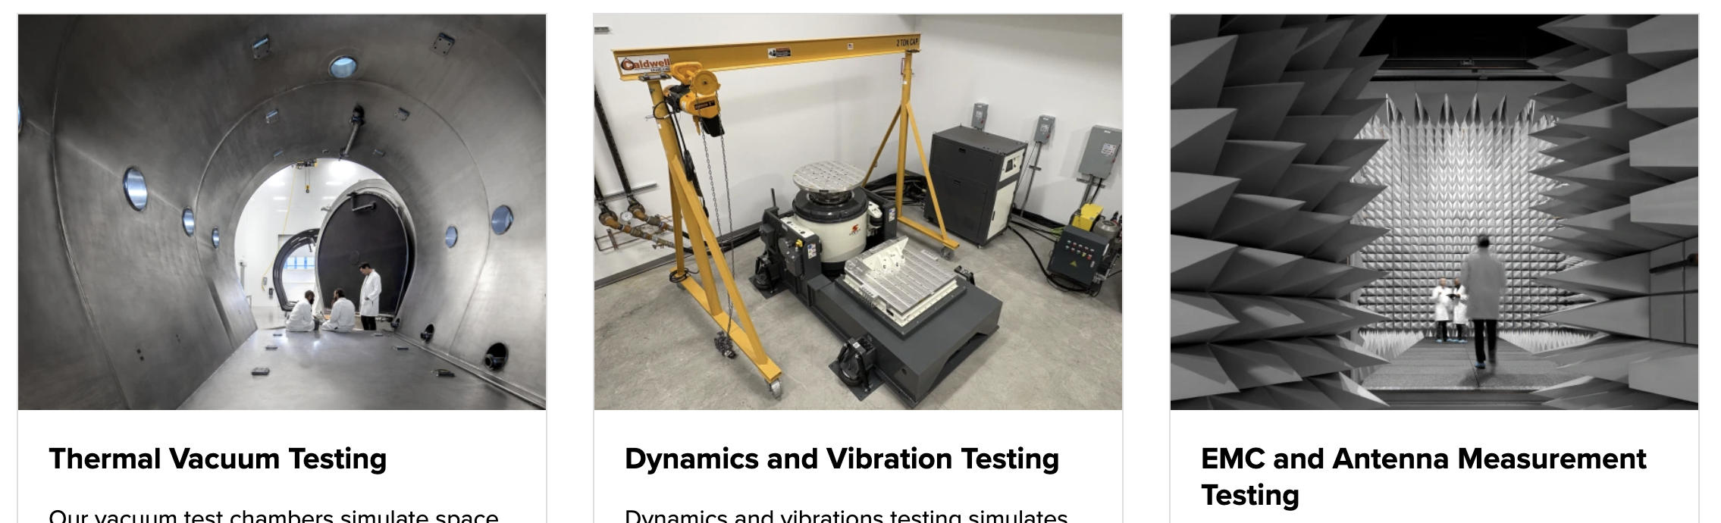
Other places for lower costs
Even larger spacecraft (for payloads above ESPA/ESPA grande class) now cost less
Environmental Testing & Mission Operations (many universities are now offering services)

Slide 13
Science Costs
This is still the same, or even growing for smaller missions
Placing data in an archive, providing tools for a wider user community beyond the science team are critical for long term success of a mission
Most SmallSats don’t have funding for a Guest Observer/Guest Investigator program and/or high-quality archiving with analysis tools.

Slide 14
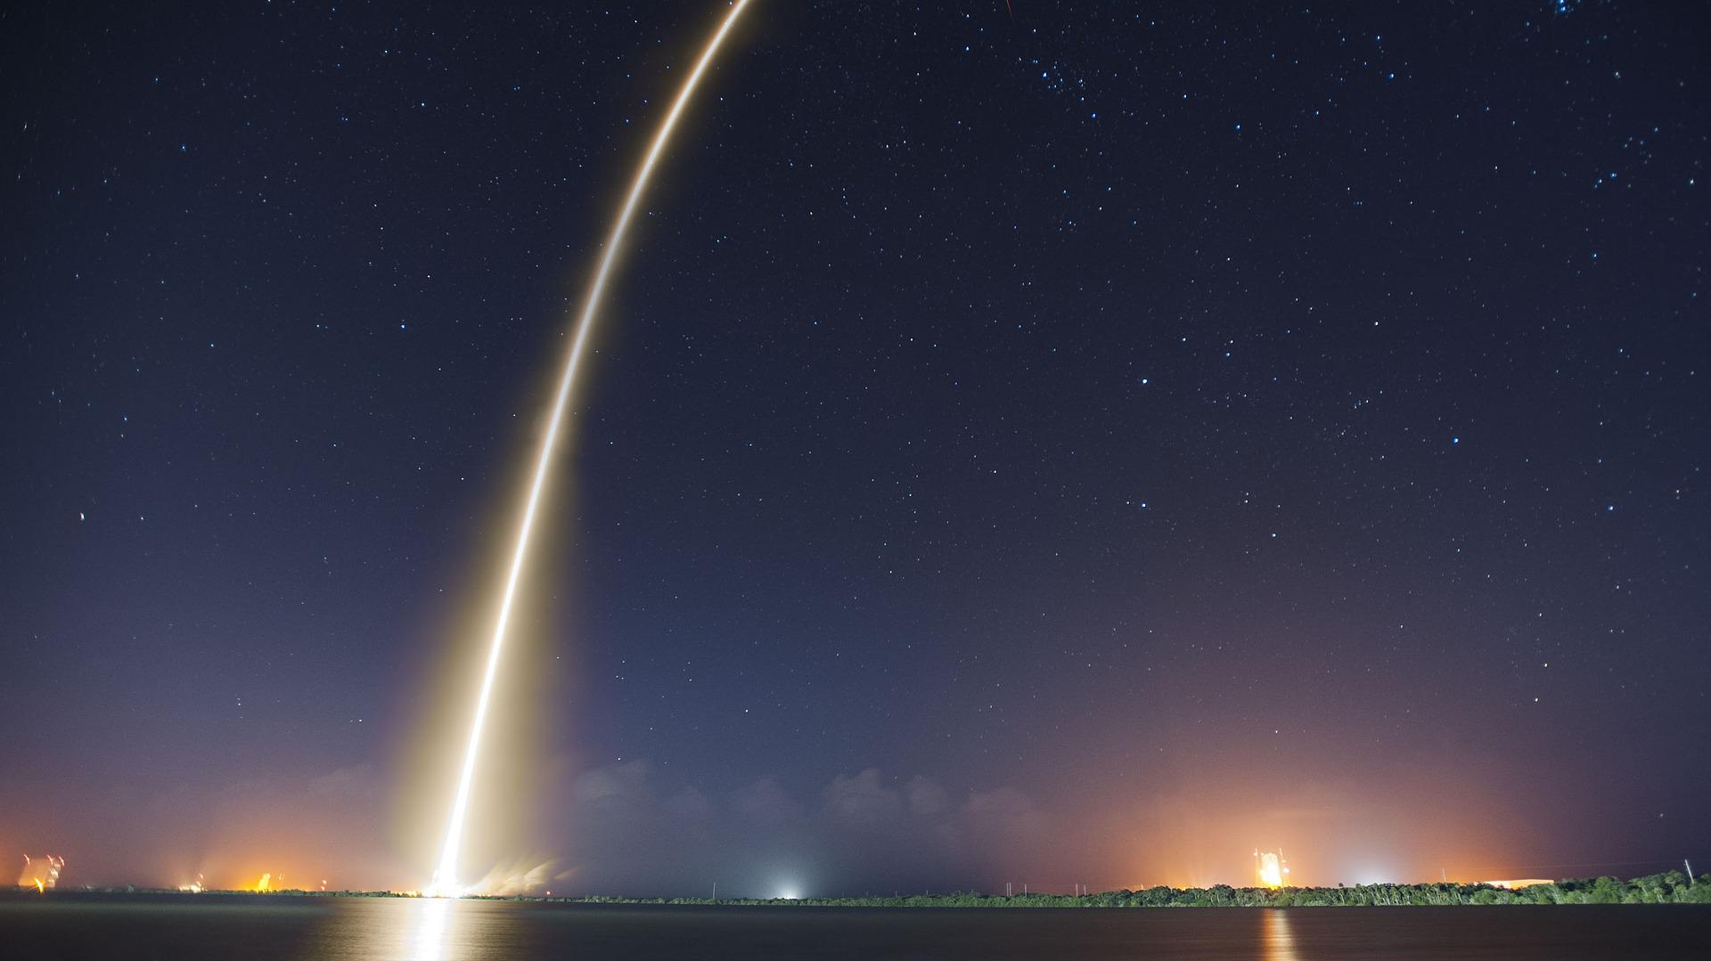
Questions?
Lots of possibilities for the right science questions
Many aspects of the mission are cheaper

